Slide 1





Web application for visually and hearing-impaired people with chatbot
Developers
J.Abinash
Fathima Firdowsiya
S.sathurshiga
Halis kaleel

Slide 2


THE
PROBLEM
1.3 Billion
people with visually and hearing impaired
0.2% - 2%
Of the world’s population

Slide 3

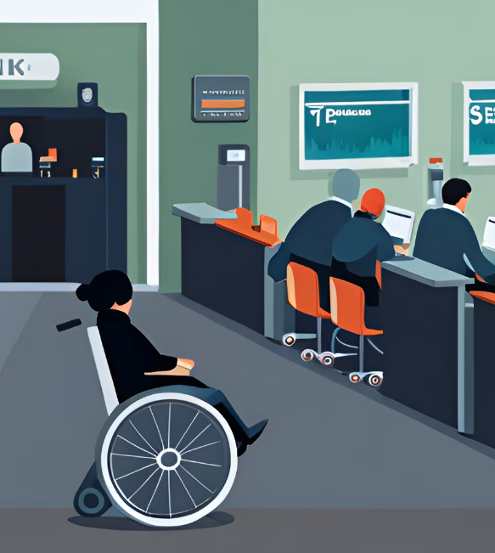
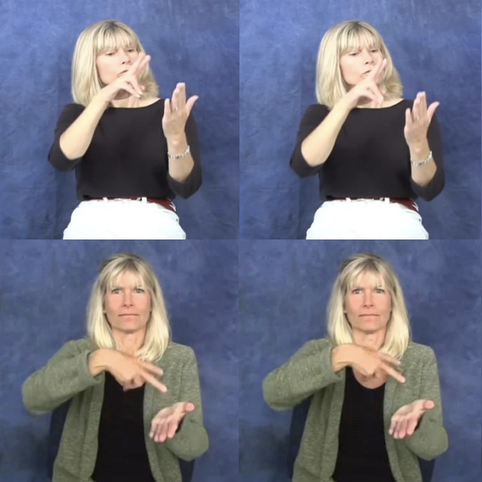


OUR
SOLUTION
Improve Online shopping experience for everyone
|
Voice enabled AI assistant
|
Enables Accessible Screening
|
Product Recommendation
|
AI Chat Bot

Slide 4
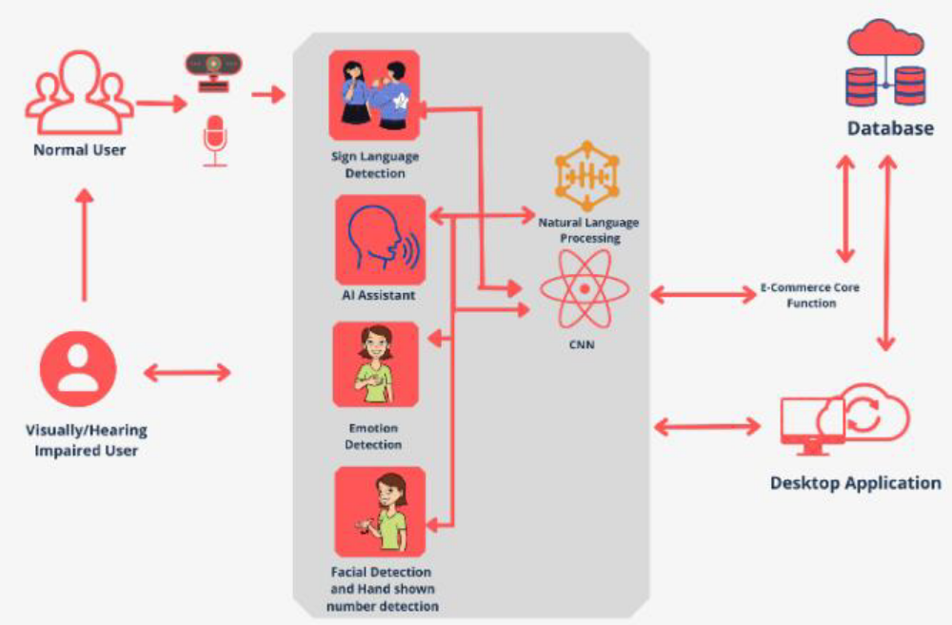
Proposed system for E-commerce digital voice assistant for visually and hearing-impaired users

Slide 5

Marketing Channels
Online advertising through social media and Google Ads
Partner with DHH organizations and influencers for promotion
Targeted online marketing campaigns.
Engage with potential users through social media and email marketing
Customer Acquisition

Slide 6
Business Concept
It is an e-commerce platform that offers a cutting-edge shopping experience for the Deaf and Hard of Hearing (DHH) community and provides an AI-powered voice assistant for all users.
Our platform includes sign language interpretation, AI-driven product recommendations, and a seamless shopping experience
To make online shopping more accessible and enjoyable for everyone, regardless of their communication preferences or abilities, by leveraging advanced AI technology.
DHH individuals and their families.
Tech-savvy shoppers looking for a convenient, voice-assisted shopping experience.
Mission Statement
Target Market

Slide 7




MARKET
VIABILITY
AI voice assistant
Sign Language recognition
Product recommentation using facial expressions
All together in one application
Feature
Our application
other
Web App

Slide 8








OUR
ROADMAP
Present
Q1
Q2
Q4
Q5
Current
Release
Adding more gestures
Expand customer base
Text to Speech, Writing features
Launch Web Application

Slide 9
An AI Voice Assistant With Special Payment Method Invocation For Differently Abled
ABINASH.J
IT20227418
Specialization : Data Science

Slide 10

BACKGROUND STUDY
Our Al voice assistant is designed to recognize the specific needs of people with disabilities. It makes easy for users to finish a number of tasks, and it is enabled using voice commands.
Most important feature is its special payment in system, which helps users pay with hand-shown numbers without touching payment systems or devices. This makes them to do transactions on their own.
Facial recognition technology has been used for payment authentication.

Slide 11
BACKGROUND STUDY
Now days visually impaired people and people with hearing impairement are totally depend on others / 100 % depend on others We have designed this project to help those people .
With this project people with visual impairement and those have hearing impairement can do 80 % of work such as order food or purchase anything online without getting help of others

Slide 12
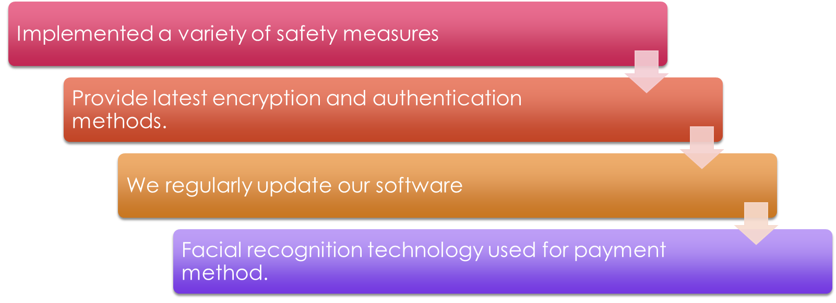
Research problem
SECURITY
n

Slide 13


Research Question
How to Improve facial recognition and fraud detection for differently-abled for payment methods

Slide 14
Main Objective
The system will use voice commands and facial recognition to make sure payments are real and secure when you buy things. This will help keep your personal information safe and reduce fraud.
The system will make it easy and safe for people with disabilities to do transactions, which will help reduce the digital divide.

Slide 15
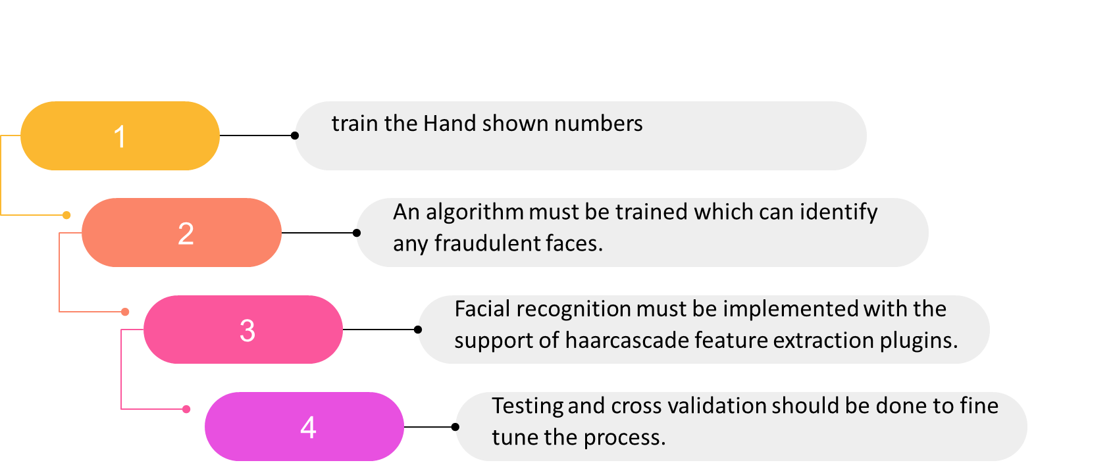
Sub objectives
Specific Objectives

Slide 16
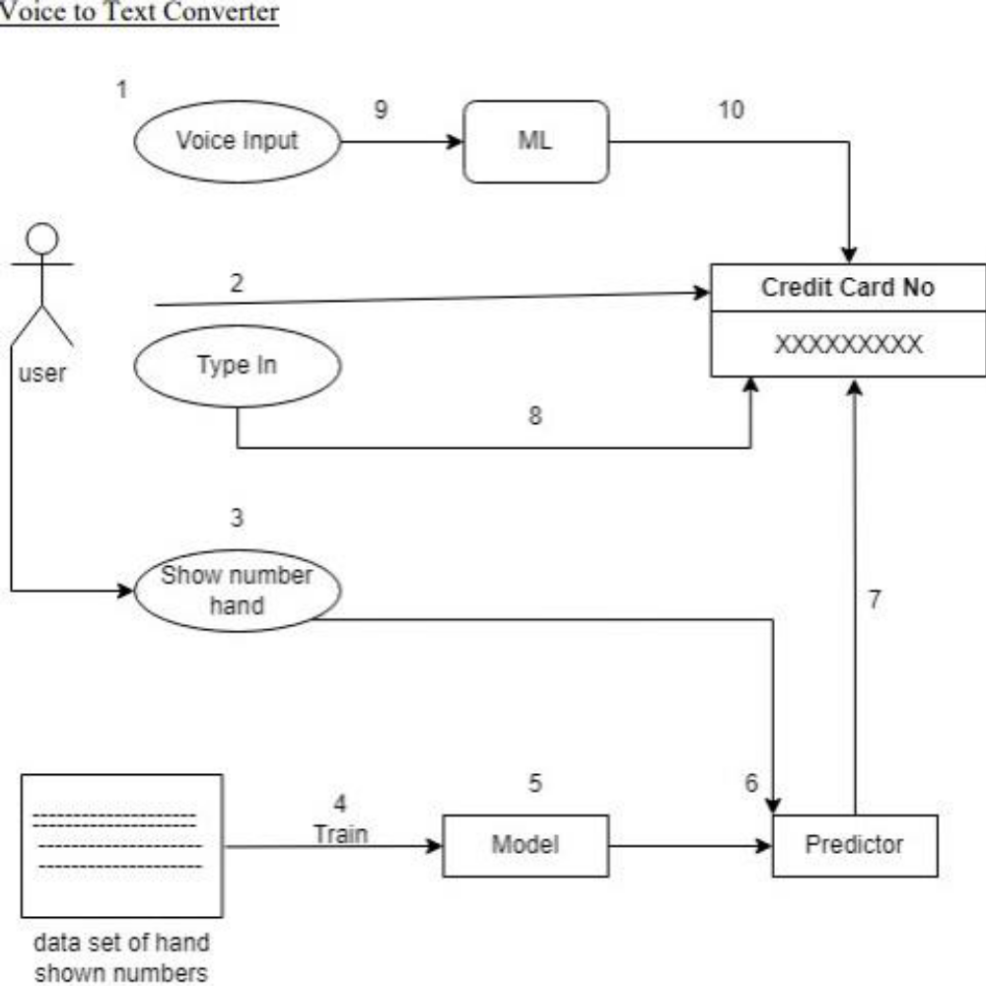
Overall System Diagram

Slide 17

Current Progress
special payment in system, which helps users pay with hand-shown numbers
Al voice assistant is designed
Facial recognition

Slide 18
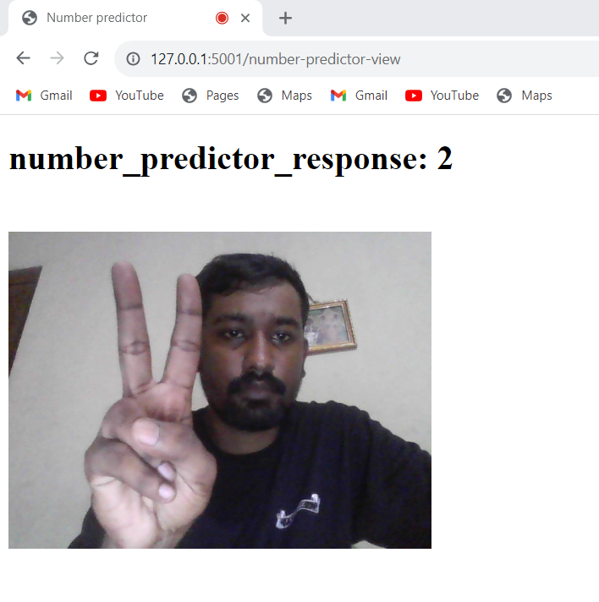
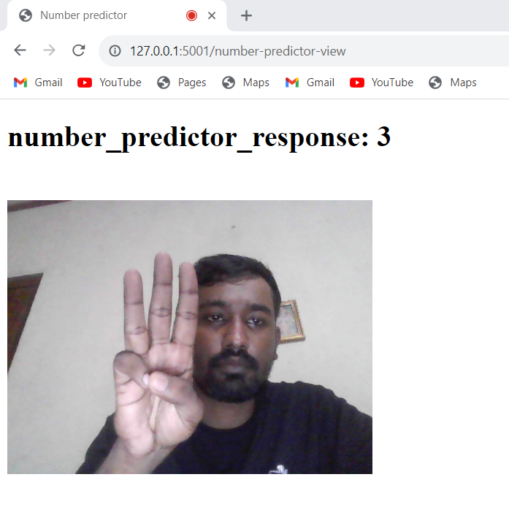
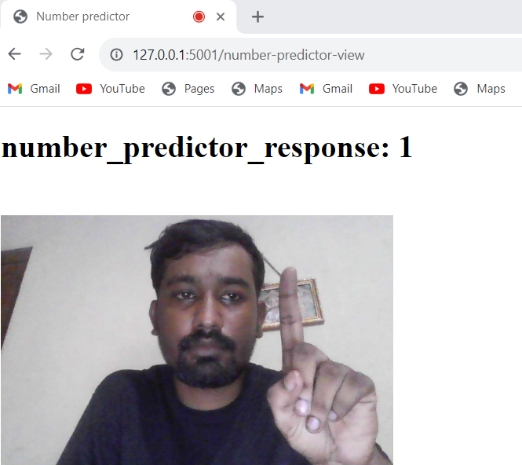
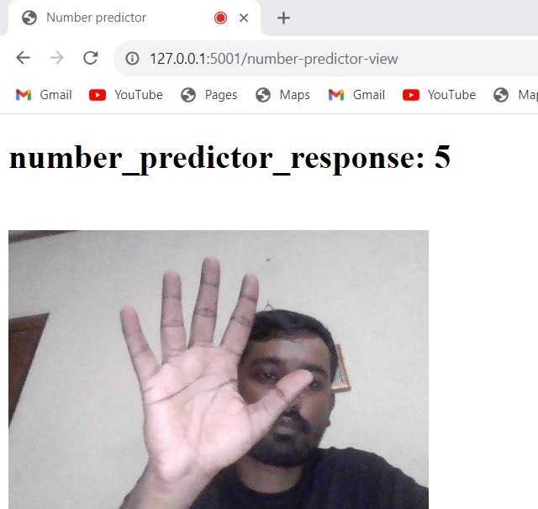
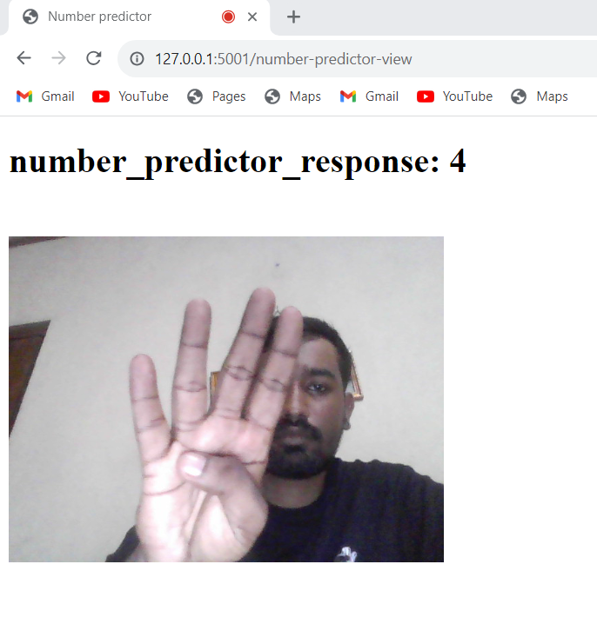
hand-shown numbers

Slide 19
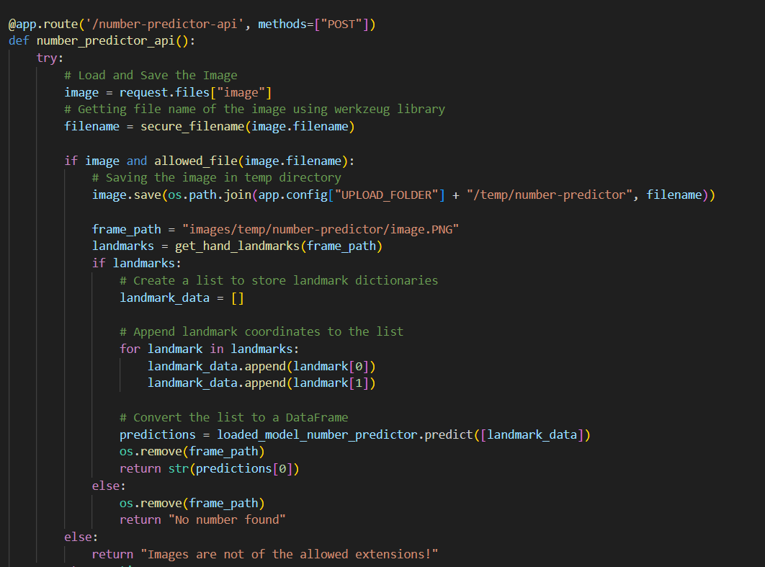
Number predictor using Hand points

Slide 20
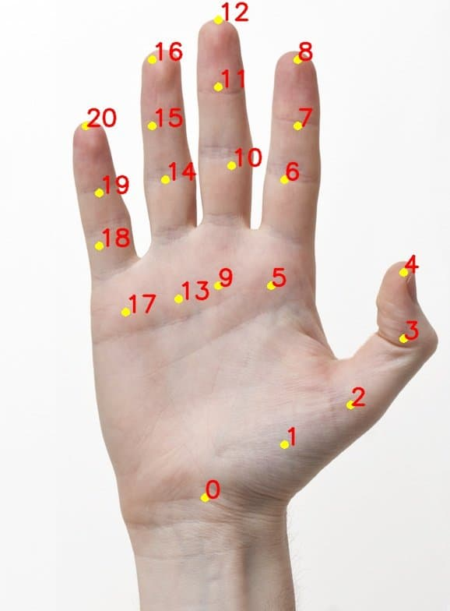
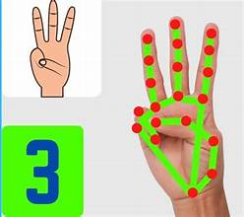
Hand points

Slide 21
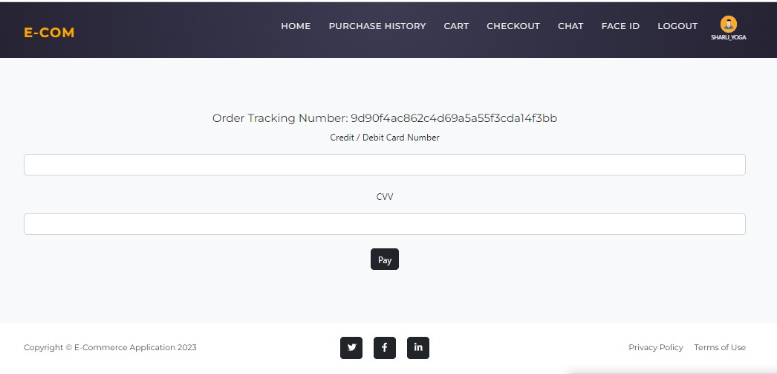

Slide 22
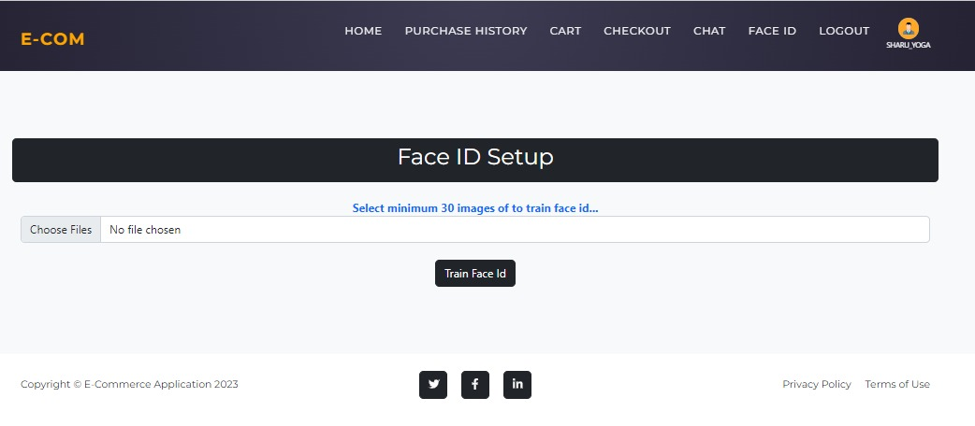

Slide 23
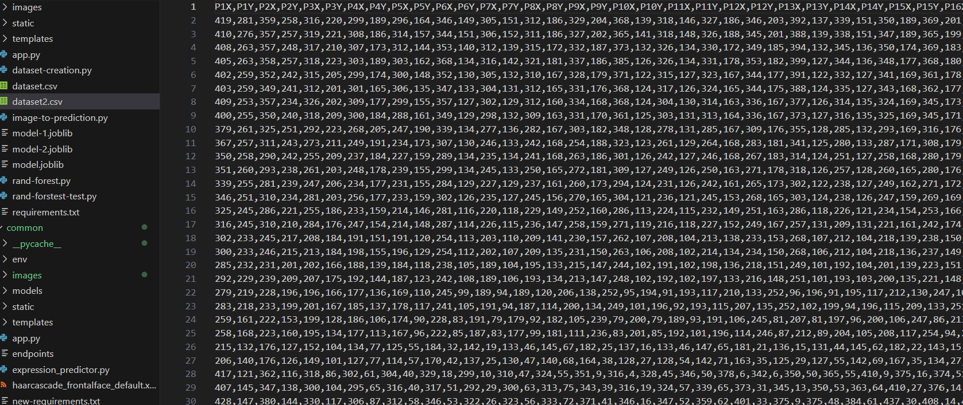
Dataset of points taken by showing numbers

Slide 24
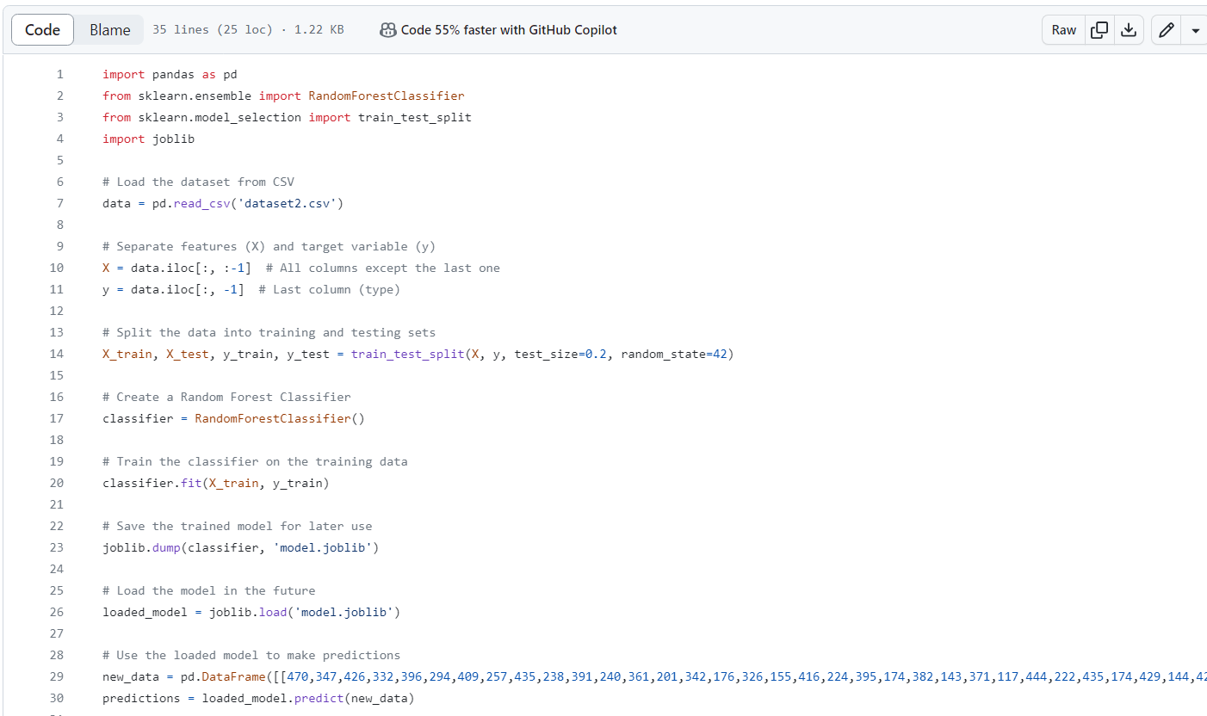
Train the Data and Generate Model Using RandomForestClassifier

Slide 25
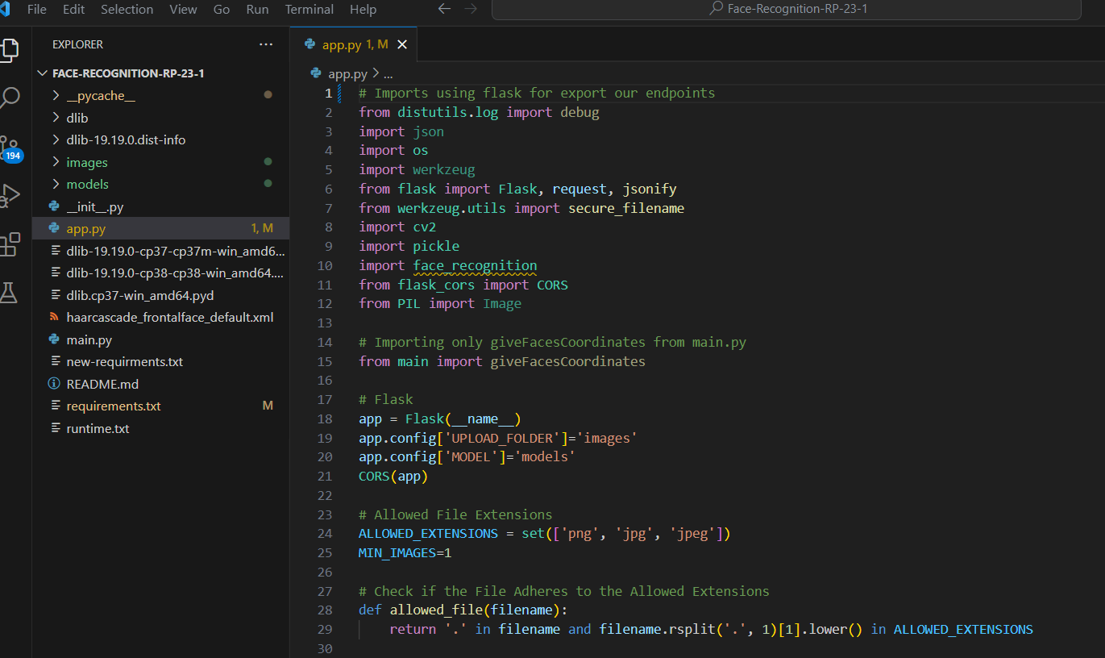
Facial recognition-Using Flask library to take out the endpoints

Slide 26
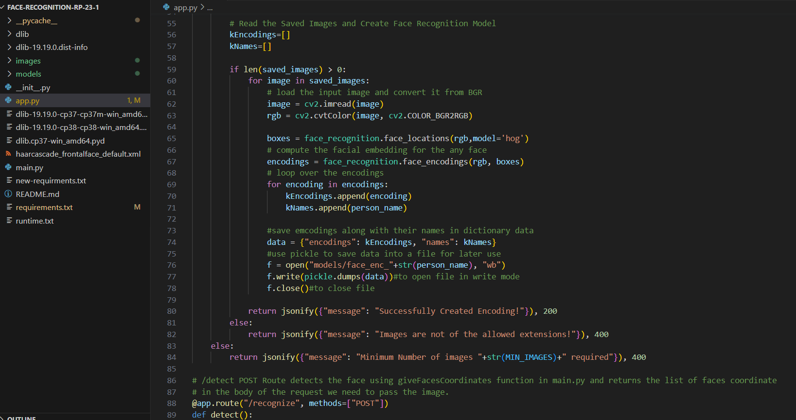
Facial recognition model for a person

Slide 27
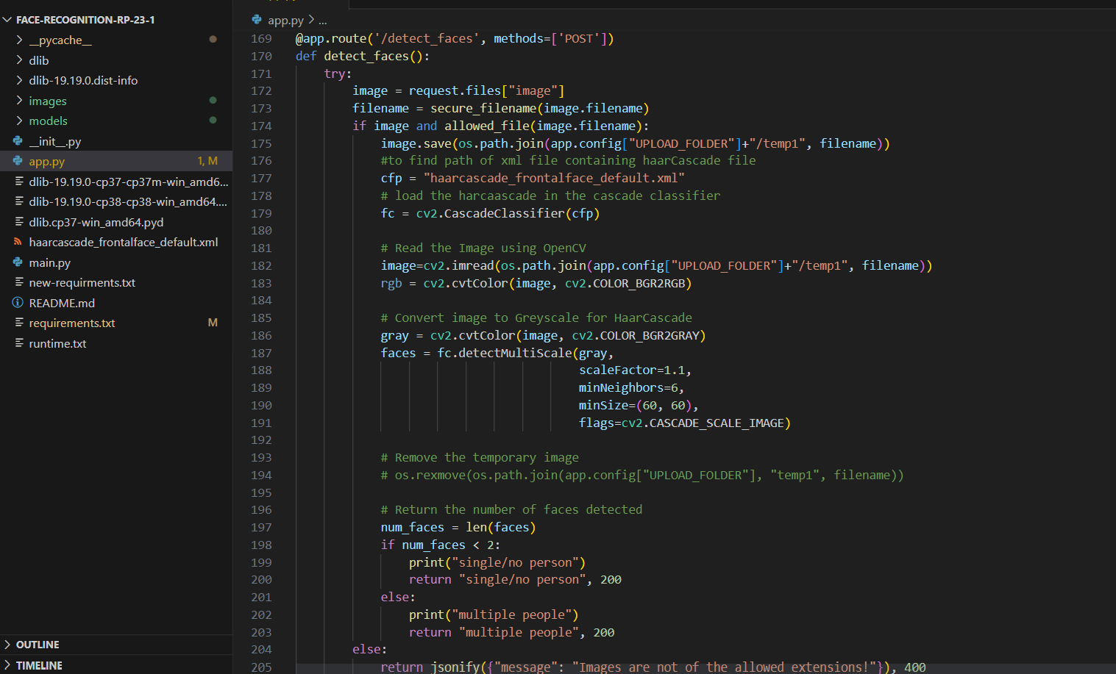
Fraudness detection of multiple faces

Slide 28
Product Recommendation System
Firdowsiya A.L
IT20011734
Specialization : Information Technology

Slide 29
BACKGROUND STUDY
Product recommendation Systems widely used by E-commerce Platforms
Emotions play a crucial role in consumer behavior and decision-making processes.
Traditional product recommendation systems
1) Rating
2) Purchase history
3) Browsing Behavior
4) Feed Back
Challenges in emotion-based recommendation systems include accurate emotion detection, overcoming biases, and ensuring privacy and ethical considerations.

Slide 30
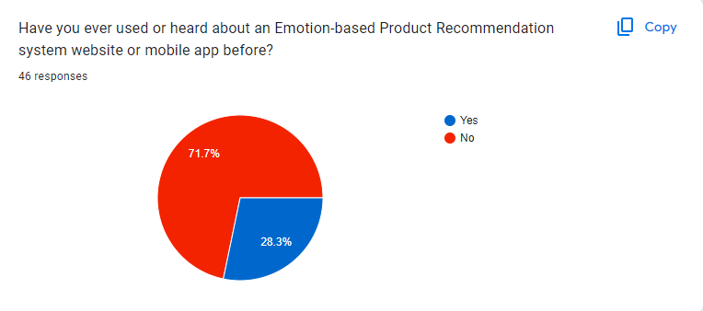
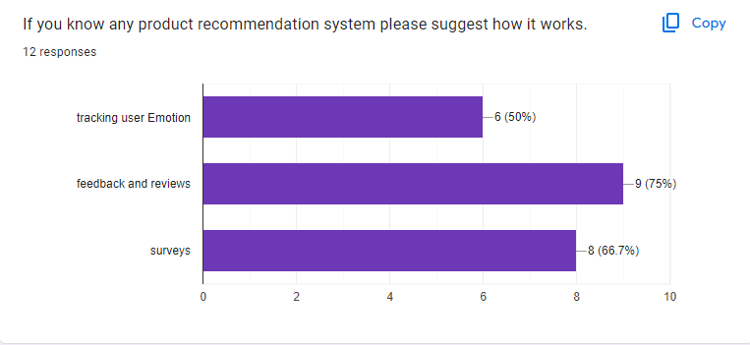
Research Finding

Slide 31
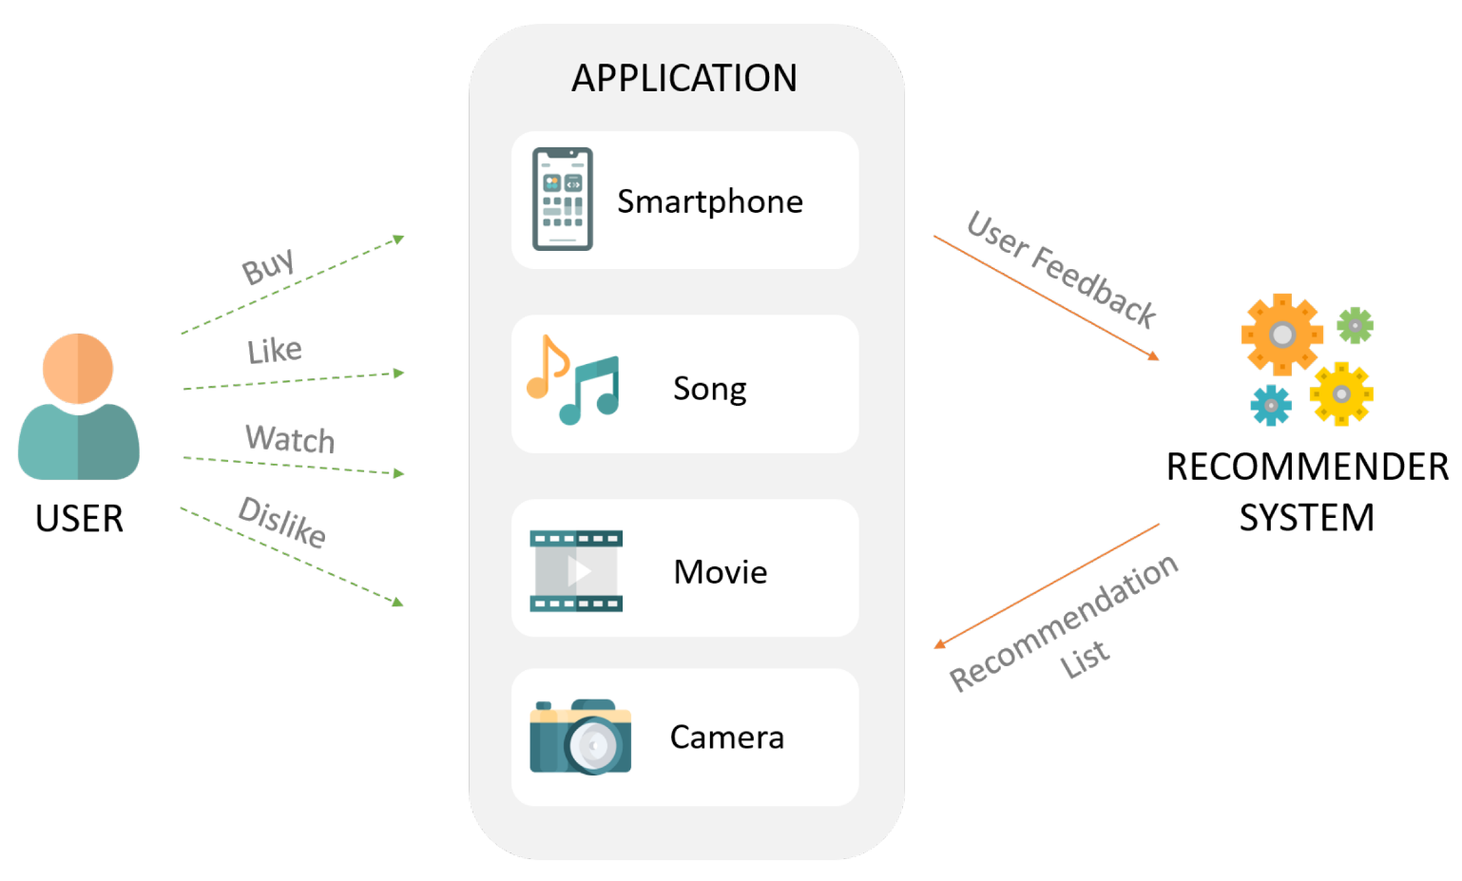
Research problem
In the current system, they use survey and history to detect the user's emotion, which is not effective enough
Existing Product recommendation Systems are focused only normal people

Slide 32
Research Question
How do you make product recommendations that recognize and respond to the emotions of customers with disabilities?

Slide 33
Main Objective
Develop an Emotion Identification Component that can accurately identify the emotions
of both normal people and those with different abilities.
Use the Emotion Identification Component to provide personalized and empathetic product recommendation service to all customers, including those with disabilities.

Slide 34
Sub objectives
Specific Objectives
Collect
Collect Diverse Dataset of Images
Train
Train CNN Model
Fine-tune
Fine-tune CNN Model
Test and Validate
Test and Validate Model
Integrate
Integrate Component with Business
Monitor
Monitor customer feedback and adjust the Emotion Identification Component and customer service protocols as necessary to continually improve the customer experience

Slide 35
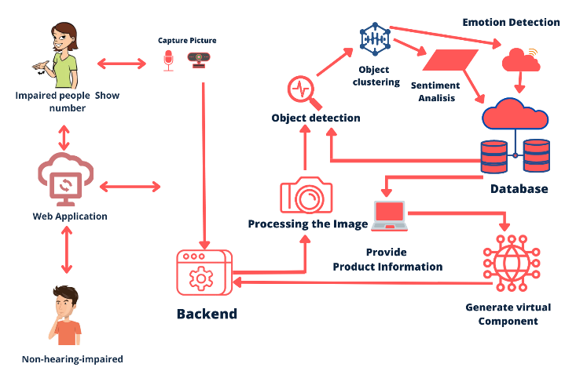
Overall System Diagram

Slide 36
happy
sad
natural
Disgusted
Surprise
System-Related Emotions

Slide 37
Current Progress
Frontend Design
Enhance the modal
Recommended product use to voice
Add voice commend for like and unlike

Slide 38
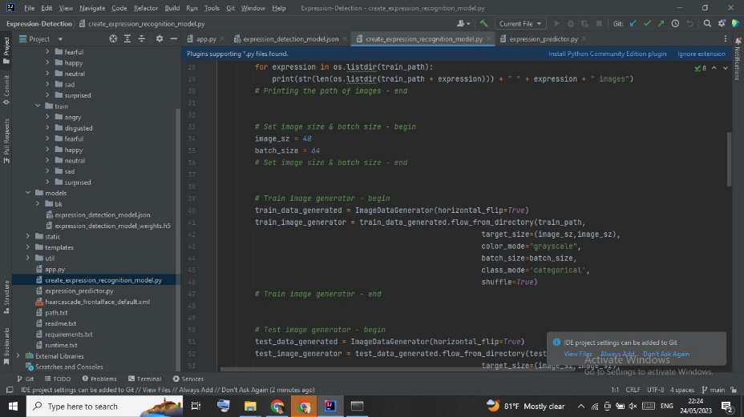
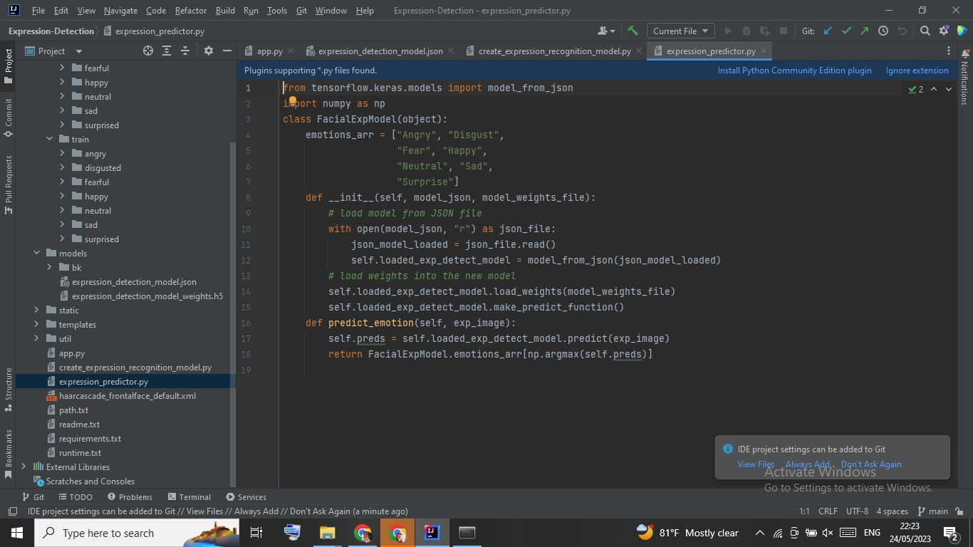
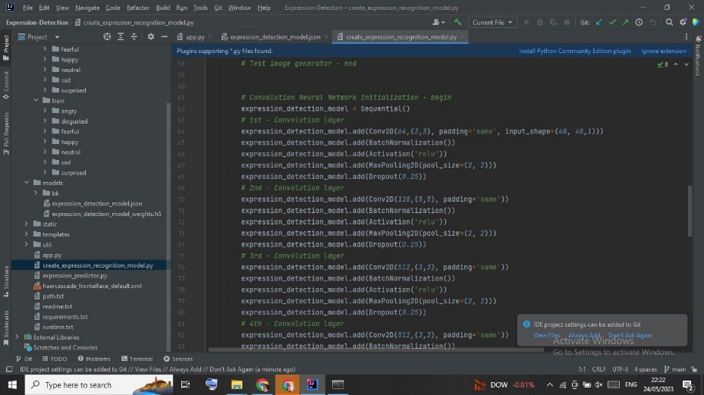
Coding

Slide 39
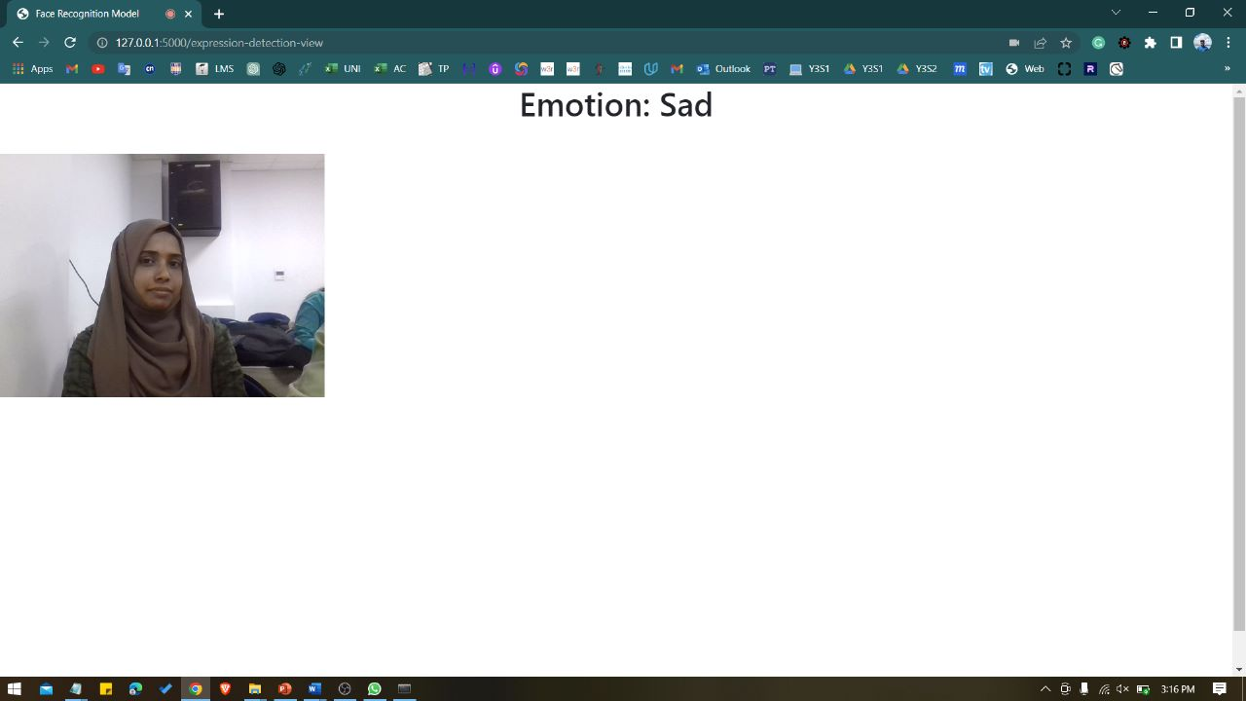
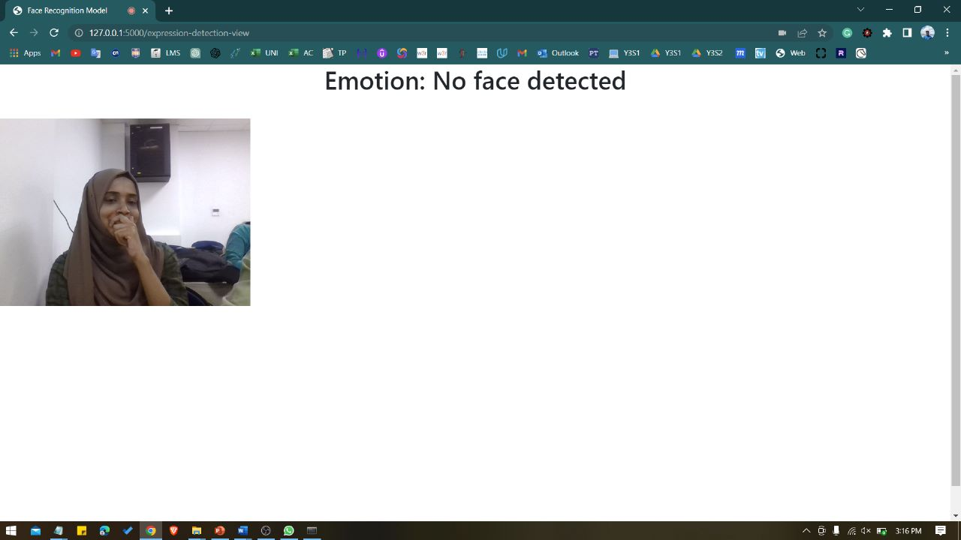
OutPut Results

Slide 40

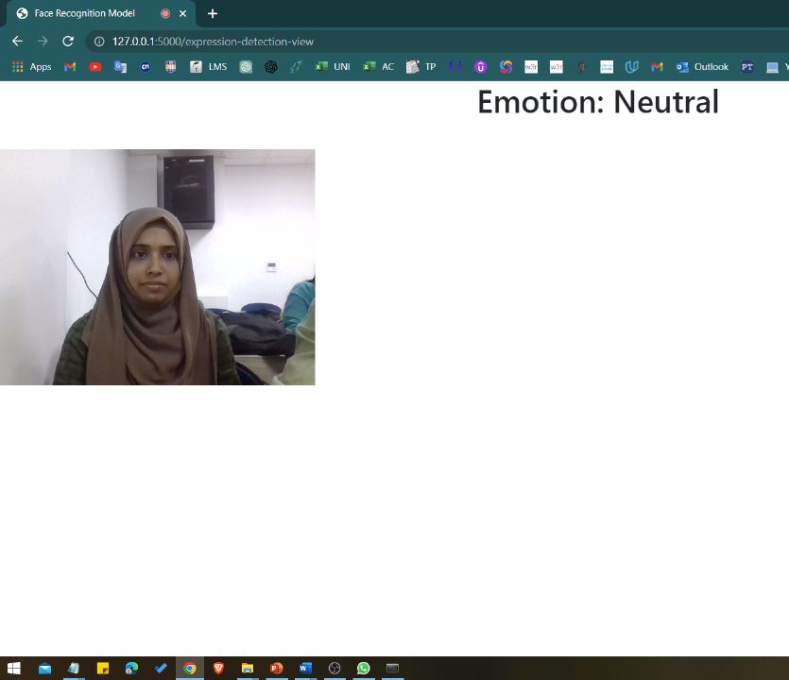

Slide 41
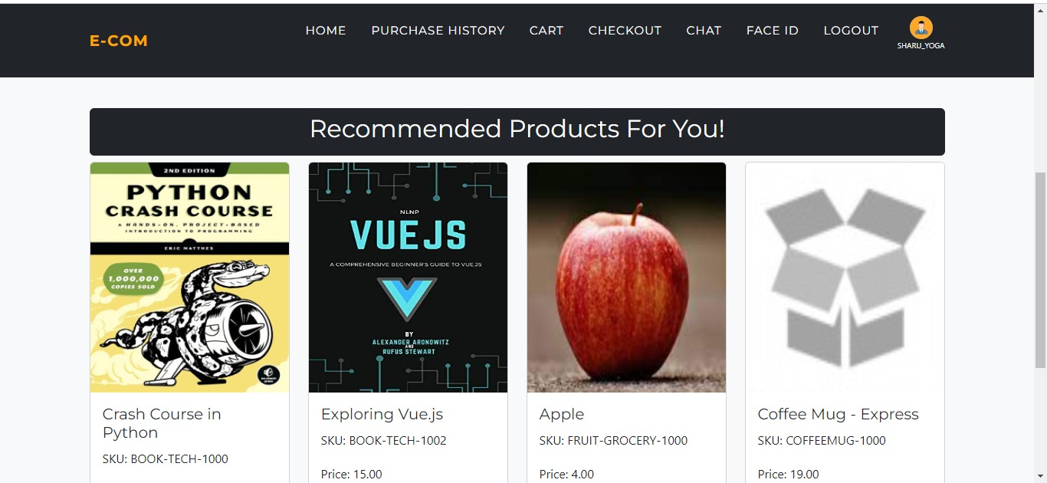

Slide 42
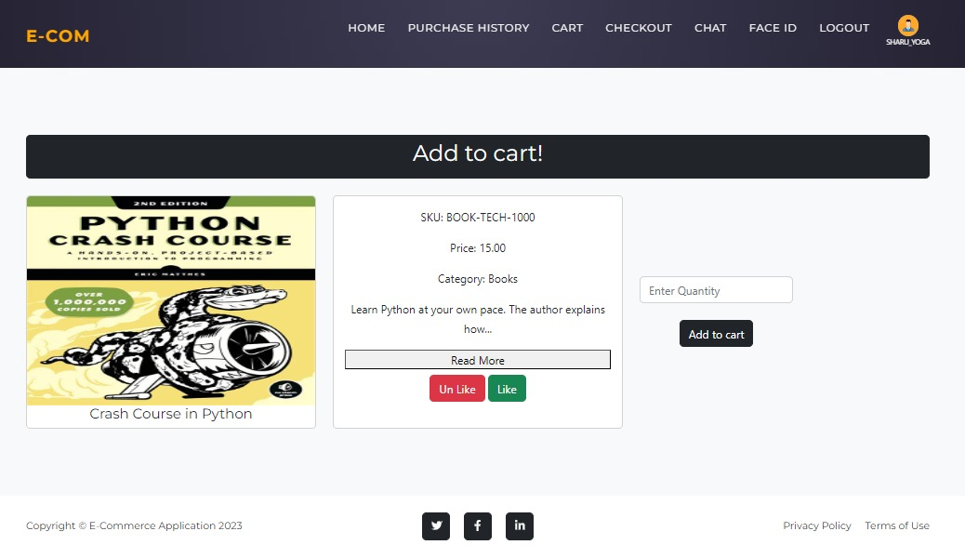

Slide 43
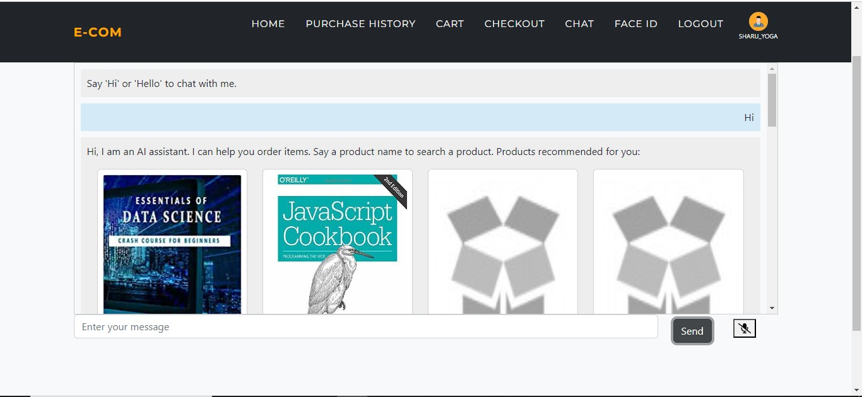

Slide 44






Tools, Technologies, Algorithms
AI/ML toolkits & Algorithms: CNN
AI/ML Libraries: opencv-python
Languages: Python, Java, HTML, CSS, JS, Jquery
Frameworks: Bootstrap, Springboot, Jinja
Data Base: MySQL

Slide 45
commertialization
Personalized Shopping Experience
Increased Customer Engagement
Enhanced Customer Satisfaction
Boosted Sales and Revenue

Slide 46
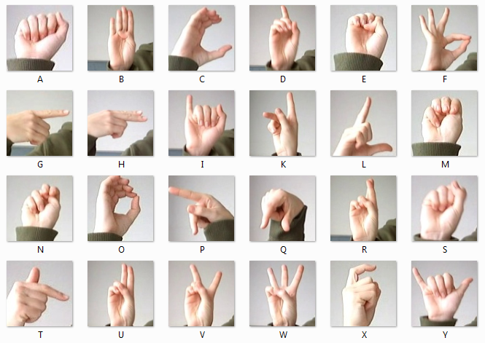
Sign Language Recognition
Sathurshiga.S
IT20114480
Specialization : Information Technology

Slide 47
Introduction - Background
Sign language recognition to online shopping websites would help deaf and hard-of-hearing people shop on their own and make the process easier for them
By integrating sign language, e-commerce sites can ensure that all customers can fully engage with and benefit from the online shopping experience

Slide 48
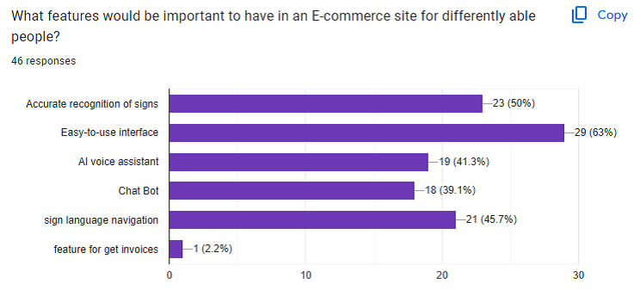
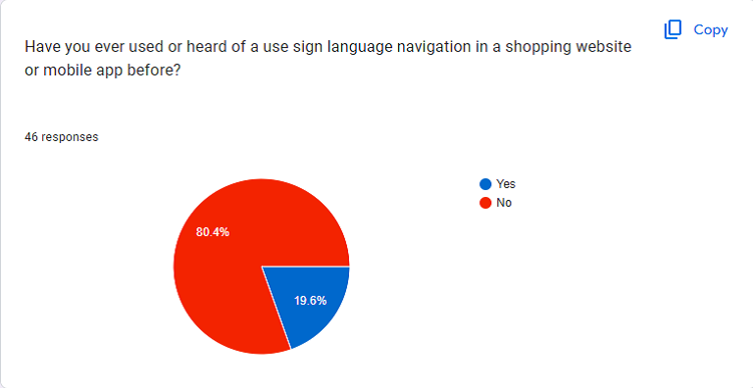
Research Finding

Slide 49

Research problem
How to complete online shopping with sign language gestures?

Slide 50





Main & Sub objectives
Main Objective
Including sign language in ecommerce platforms
COLLECT
Sign language action videos
TEST
Test & Improve model’s accuracy
TRAIN
Label & Segment clips for training
FINE - TUNE
Extract points from video clips

Slide 51
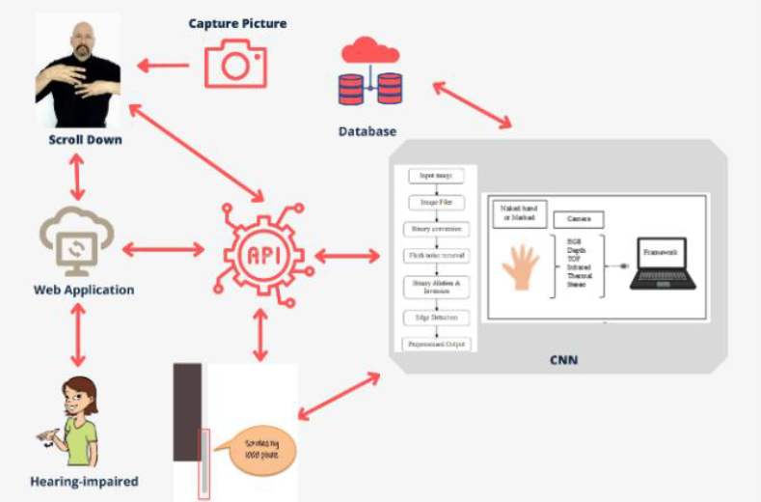
Overall System Diagram

Slide 52
Current Progress
Integrate front end with sign language detection tool
Add more hand gestures
User testing
Create front end for Dynamic interaction and use functionalities

Slide 53
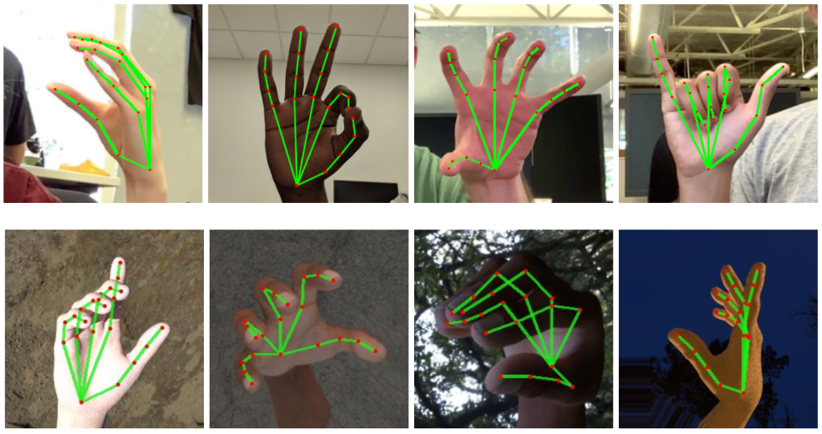
Hand Sign Detection

Slide 54
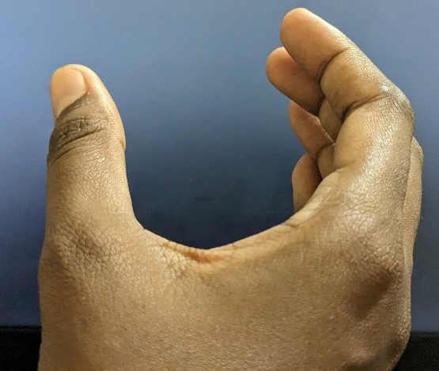
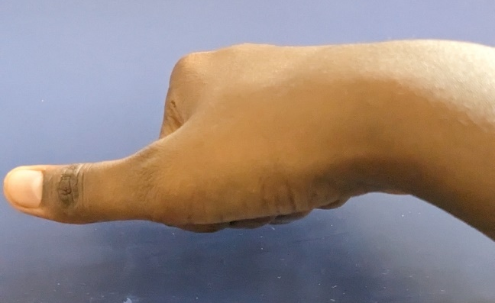
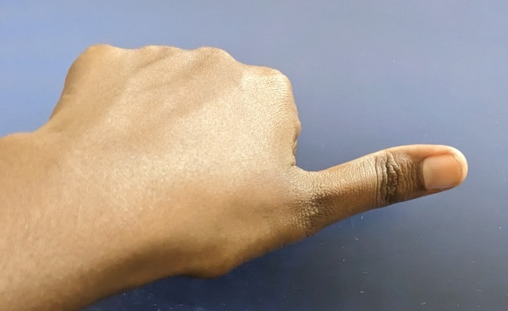
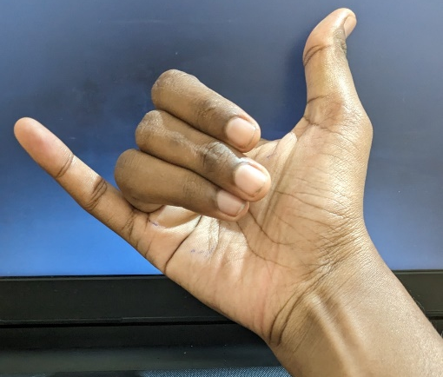
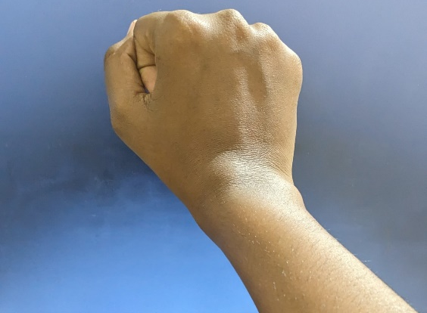
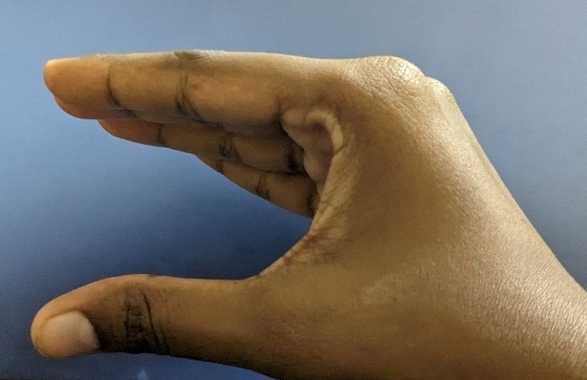
Hand gestures used in the system
Previous
Next
Cart
Chatbot
Checkout
Scroll up & down

Slide 55
Tools, Technologies, Algorithms
AI/ML toolkits & Algorithms: CNN
AI/ML Libraries: opencv-python
Languages: Python, Java, HTML, CSS, JS, Jquery
Frameworks: Bootstrap, Springboot, Jinja
Data Base: MySQL

Slide 56
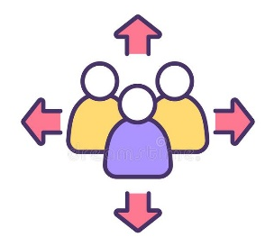



Commercialization
Expand Customer Base
Enhanced Accessibility
Improve User Experience
Partnership Opportunities

Slide 57
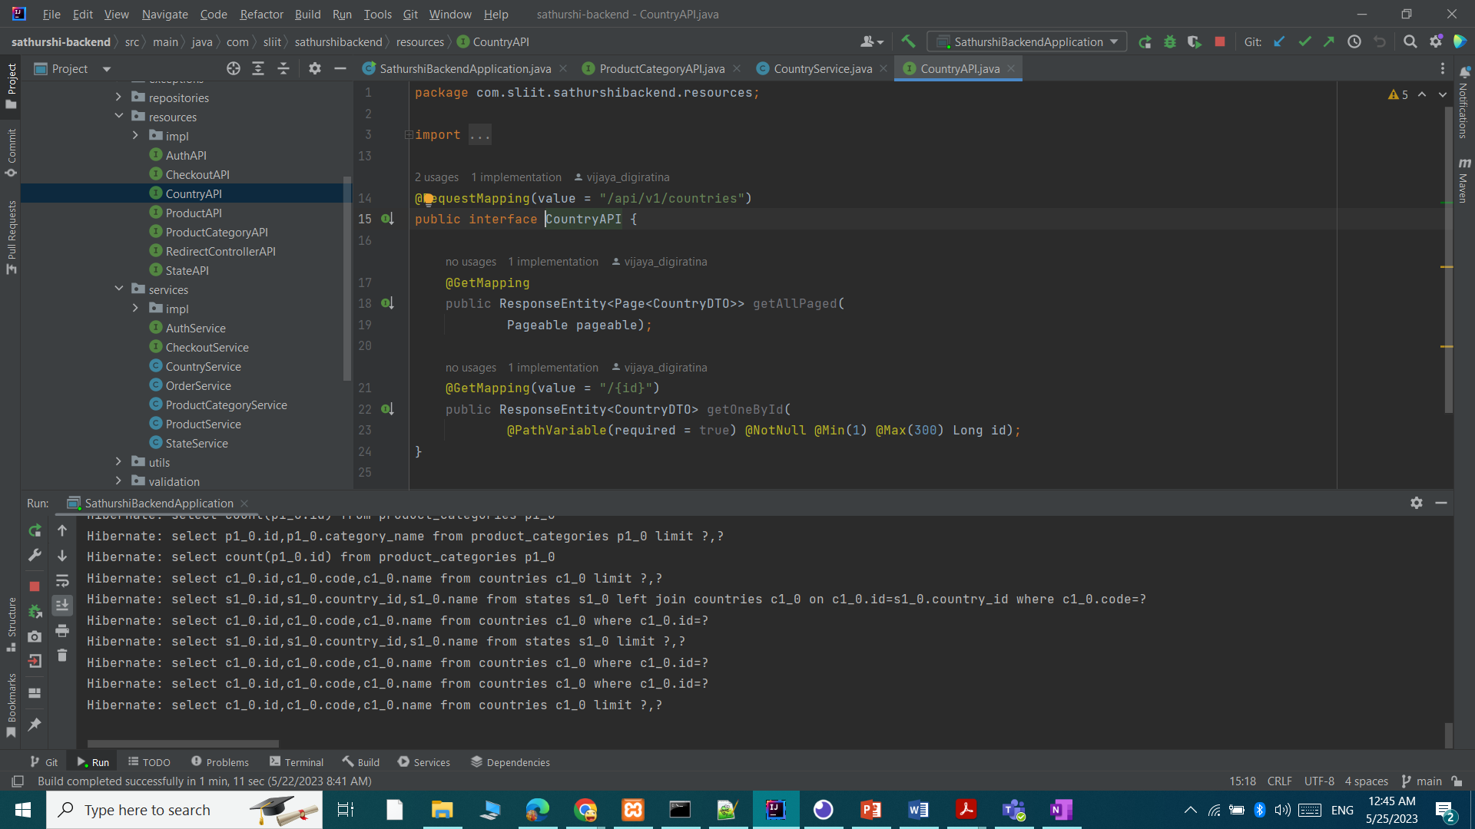

Coding

Slide 58
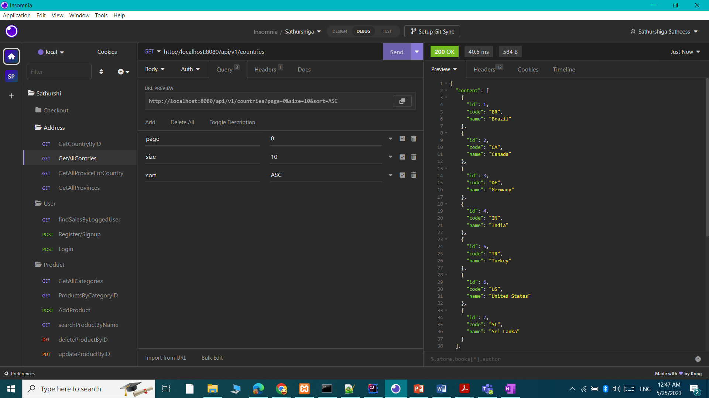
Expected output

Slide 59
AI chat Assistant With Generic Enhanced
Management Component
IT20198718
HALIS M.K.M
Specialization : Data Science

Slide 60
Background study
Businesses need chatbots to provide efficient customer support, handle large volumes of queries, and personalize customer experience.

Slide 61
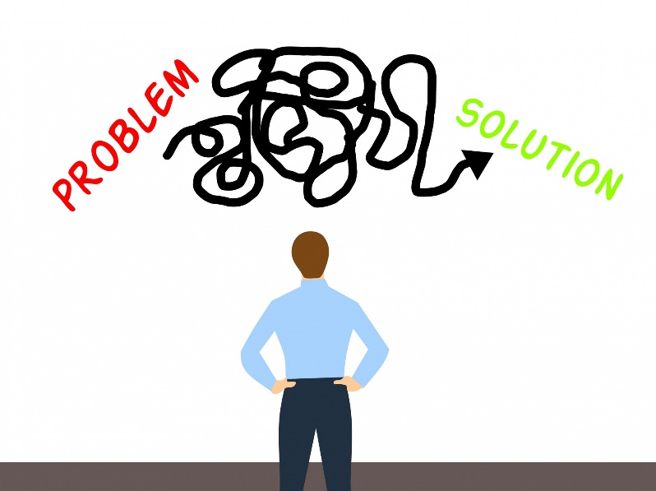
Research problem
ChatBots not exclusively made for differently abled individuals (Hearing impaired and Visual impaired individuals)
Giving content based personalized user experience
Existing ChatBots often struggle with handling complex dialogues

Slide 62

Research Question
How effective is incorporating diverse inputs and an efficient dialogue management component in developing a chatbot system for differently abled individuals?
How does it compare to existing systems in terms of inclusivity, efficiency, and user-friendliness?

Slide 63
Main Objective
Develop a comprehensive AI chat assistant system that understands diverse inputs, provides an efficient dialogue handling process, and offers an inclusive, user-friendly interface for differently abled individuals.

Slide 64
Sub objectives
Sub Objectives
1
Train NLU model with relevant data that is specific to the needs of differently abled users to understand and respond to diverse inputs.
2
Train dialogue management system to handle complex dialogues and tailor responses.
Develop a personalized machine learning algorithm to improve chatbot performance.
4
Testing and cross validation should be done to fine tune the process
3

Slide 65
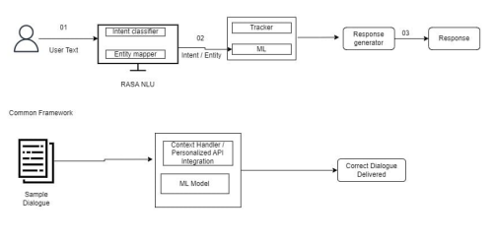
Overall System Diagram

Slide 66
Current Progress
Integrate both Rasa Core and Rasa NLU.
Train the model with various inputs.
Finalize front end and take more than
Testing for functionality and possible improvements

Slide 67


Slide 68


Slide 69

Chat-core

Slide 70



Rasa-NLU

Slide 71
Tools, Technologies, Algorithms
AI/ML toolkits & Algorithms: CNN
AI/ML Libraries: OpenCV-python
Languages: Python, Java, HTML, CSS, JS, jQuery
Frameworks: Bootstrap, Springboot, Jinja
Data Base: MySQL

Slide 72
Commercialization
Market Opportunity
Integrated into various business and organizations.
Continuous Improvement and Updates
Improved communication and accessibility

Slide 73
Thank You

